Slide 1
Report
May-2023 MP Inspection BFX – AT100
Date : 17-Aug-2023
Prepared by: Rachel Ruan

Slide 2
Issue Description
20-Jun, ALT customer complain [BFX-AT100] May & June – 2023 Mass production issue.
Overall inspection result => Fail ( Waived, due to product launch schedule )
Defect Total:
•Critical
No HDMI Output * 1pcs
UI broken * 1pcs
Abnormal reboot after System hang up * 1pcs
• Minor
HDMI Cable function NG* 1 pcs

Slide 3
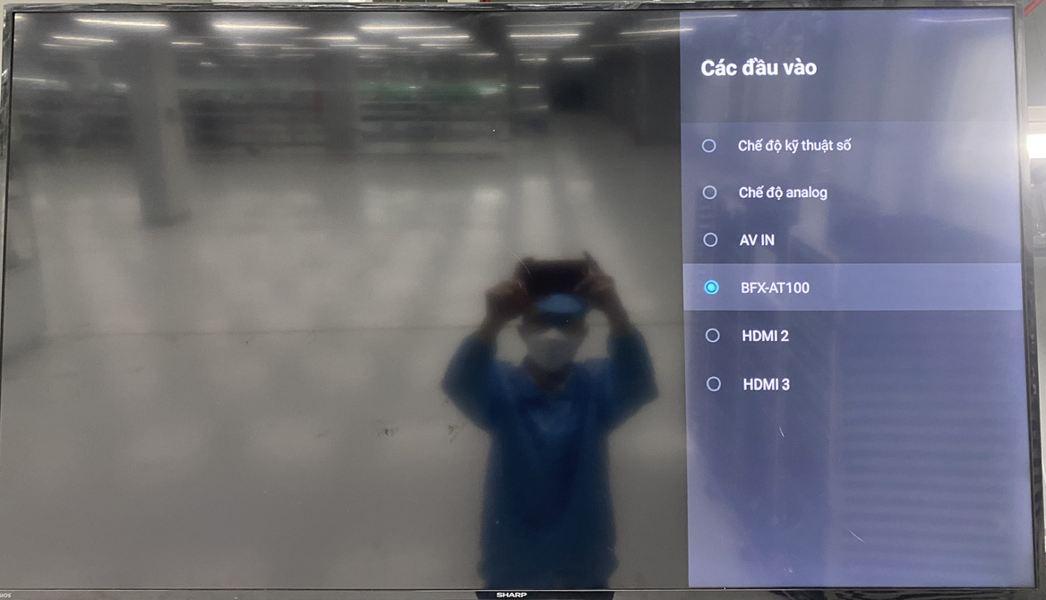
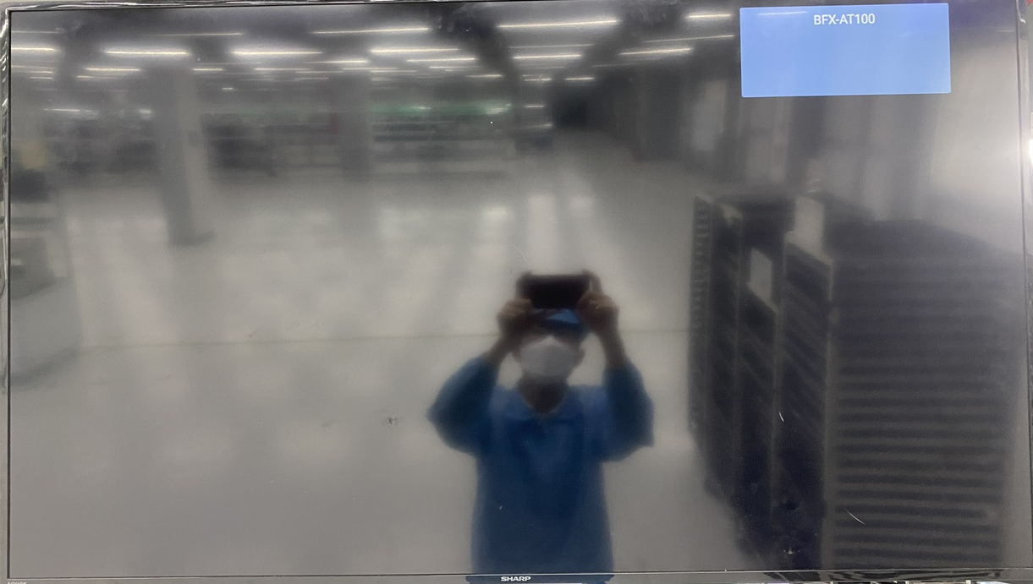
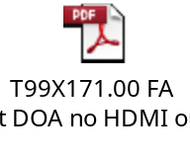
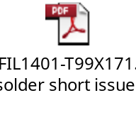
1. No HDMI Output - No HDMI TV screen
Issue Description | Root cause | Actions | Status
Symptom: No HDMI TV screen Type: Critical Defect unit Q’ty : 1pcs / 1000pcs Defect rate : 0.1% SKB SN: 2149688001202301131672 | 1. Check FATP data → Product test pass normally. FA : 2.1 Recheck production data record and test log ➔ Did not find out any abnormal. 2.2 Retest NG sample at OBA station => The fail symptom same as customer feedback. Use TV Sharp 32inch, 50inch, 60inch and TV SAMSUNG 50inch. => Result No HDMI TV screen. 2.3 Upgrade again factory FW and test NG sample at FT, FT1 station => Pass normally. => FATP station can’t cover this issue (The environment of 4K HDMI capture card is not the same TV) 3. Root Cause: 3.1: Occurrence Root Cause : Check visual inspection and take X-ray➔ Result: FIL1401 location solder short. Focus HDMI block, because FIL1401 solder short so TX2N and TX1P of HDMI port short with 7,7 Ohm. 3.2: Escape Root Cause : FATP station can’t cover this issue . | 1. Update SOP VI PCBAs 100% at location FIL1401 & FIL1402 with the magnifier . ( Owner IE: Ms.Yen – Done 03/Jul). 2. Update new environment at RC1 station of FATP. As the verification result, new environment at RC1 station of FATP can cover error no HDMI TV screen. (Owner: TE Jones ,status: Done 08/18). 3. Fii applies new environment at RC1 into production to cover this issue. (Owner: TE Jones ,status: Done 08/18).
No screen HDMI

Slide 4
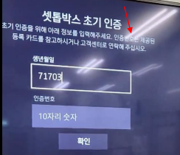
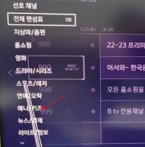
2. UI broken - UI Screen is unstable (broken)
Issue Description | Root cause | Actions | Status
Symptom: UI Screen is unstable (broken) Type: Critical Defect unit Q’ty : 1/1000pcs Defect rate : 0.1% SKB SN: 2149688001202301117565 | ALT initial review • Check visual status -> No found abnormal • TV change (LG/Samsung), HDMI Cable change -> still has defect Check FATP data → Product test pass normally. Suggestion: Update customer SW Measure impedance HDMI block. | PE on analysis : Due date 31-Aug

Slide 5
3. Abnormal reboot after System hang up
Issue Description | Root cause | Actions | Status
Symptom: Abnormal reboot after System hang up Type: Critical Defect unit Q’ty : 1pcs / 1000pcs Defect rate : 0.1% SKB SN: 2149688001202301146495 | Symptom • Normal operation for several minutes after power on • Abnormal reboot and System hang up ALT initial review • Check visual status -> No found abnormal • USB log is attached : Log.zip 1. Check FATP data → Product test pass normally. 2. Suggestion: - Update customer SW - Measure impedance & voltage power: DC_5V, P1V2, P2V5, P3V3, VDDF(3.3V), VDDCPU(0.88V), VDD_EE(0.83V), P1V8 | PE on analysis : Due date 31-Aug

Slide 6

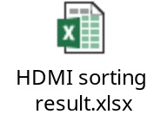
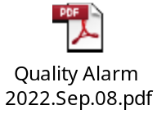
4. HDMI Cable function NG
Issue Description | Root cause | Actions | Status
Symptom: HDMI Cable function NG Type: Minor Defect unit Q’ty : 1/1000pcs Defect rate : 0.1% SKB SN: 2149695001202201009369 | 1. Fail symptom: As ALT feedback that they found out 1pcs No HDMI Output screen on the TV. 2. Check HDMI data: PN: 371.01057.005 Vendor : FIT Description : CABLE HDMI 19P 1800+-30mm BLACK GP Qty : 1pcs 1. HDMI incoming cosmetic & function issue, Fii feedback to FIT vendor and request 8D report to FIT Quality team . Done: 01-Jul-2023 2. IQC OP no defect this issue when checking HDMI incoming material. 3. Online product no check accessory cosmetic , OBA check accessory follow AQL 0.65, no defect this issue. | 1. Hang quality alarm on IQC control HDMI cable incoming this issue, if IQC defect, will reject HDMI cable back vendor. 2. Add to IQC-SIP checking HDMI cosmetic the NG picture. Status: Done 3. Hang quality alarm at OBA station for OP doing notice it. Status : Done. 2. Add to SIP OBA check cosmetic and function HDMI ( accessory checking ). Status : Done. 3. FIT update sorting result. No detect fail issue.

